Slide 1
Continuous cyber security education
Oleksii Baranovskyi
Ph.D., CISSP, ESCS, CHFI, CEH etc.

Slide 2
State of Art
45 universities (technic, classical, economic, pedagogic, architect etc.)
Issues:
Programs / Materials
Technical equipment
Lecturers
Time

Slide 3
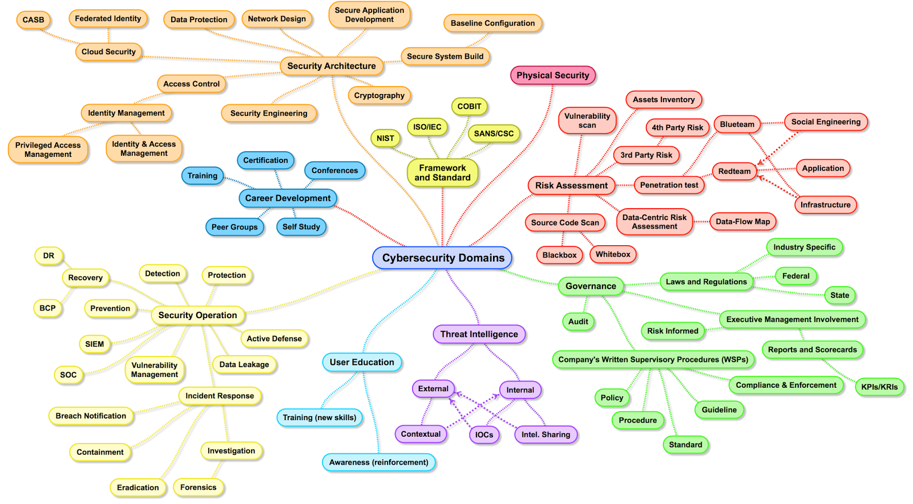
Cyber Security Landscape

Slide 4
Program Structure
Disciplines
Knowledge
Competency
Profession

Slide 5
Example
“ How to learn Web Security without Networks?“

Slide 6
Lecturer Responsibilities
Education
Preparation

Slide 7
Problems
University education quality / coverage
Rapid profession evolution
Additional / related knowledge necessity
… here we we must run as fast as we can, just to stay in place. And if you wish to go anywhere you must run twice as fast as that. © Lewis Carroll

Slide 8
Who Can Help?
Help themselves
Stay hungry! Stay tuned! © Steve Jobs

Slide 9
Sources
Open / commercial educational platforms
Vendors education materials / certification
Vendor neutral certifications
Web

Slide 10
Web
YouTube
Articles
Forums
Krebs
SecurityTube?
Torrents
Feeds
CVE/CVSS/NVD
Reports
Etc.

Slide 11
Problem
You need to know what do you want!
Would you tell me, please, which way I ought to go from here?
That depends a good deal on where you want to get to.
I don’t much care where!
Then it doesn’t matter which way you go.
© Lewis Carroll
Motivation.

Slide 12
Educational Platforms
Udemy
Cybrary
HackTheBox
Hacking Lab
PentestIt
ENISA
CyberCombat
HackerU
CyberRange
CTF365
CyberDesc
CIRT
Etc.
Etc.
Etc.
Etc.
Etc.
Etc.
Etc.
Etc.
Etc.
Etc.
Etc.
Etc.

Slide 13
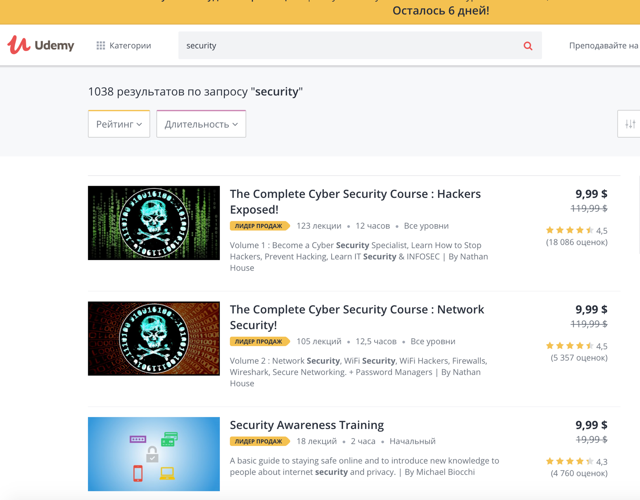
Educational Platform - Udemy
https://udemy.com

Slide 14
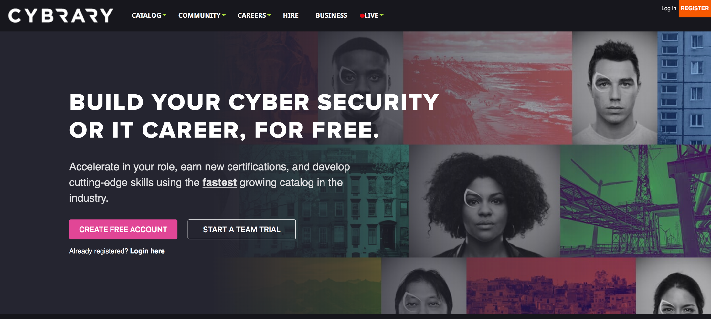
Educational Platform - Cybrary
https://cybrary.it

Slide 15
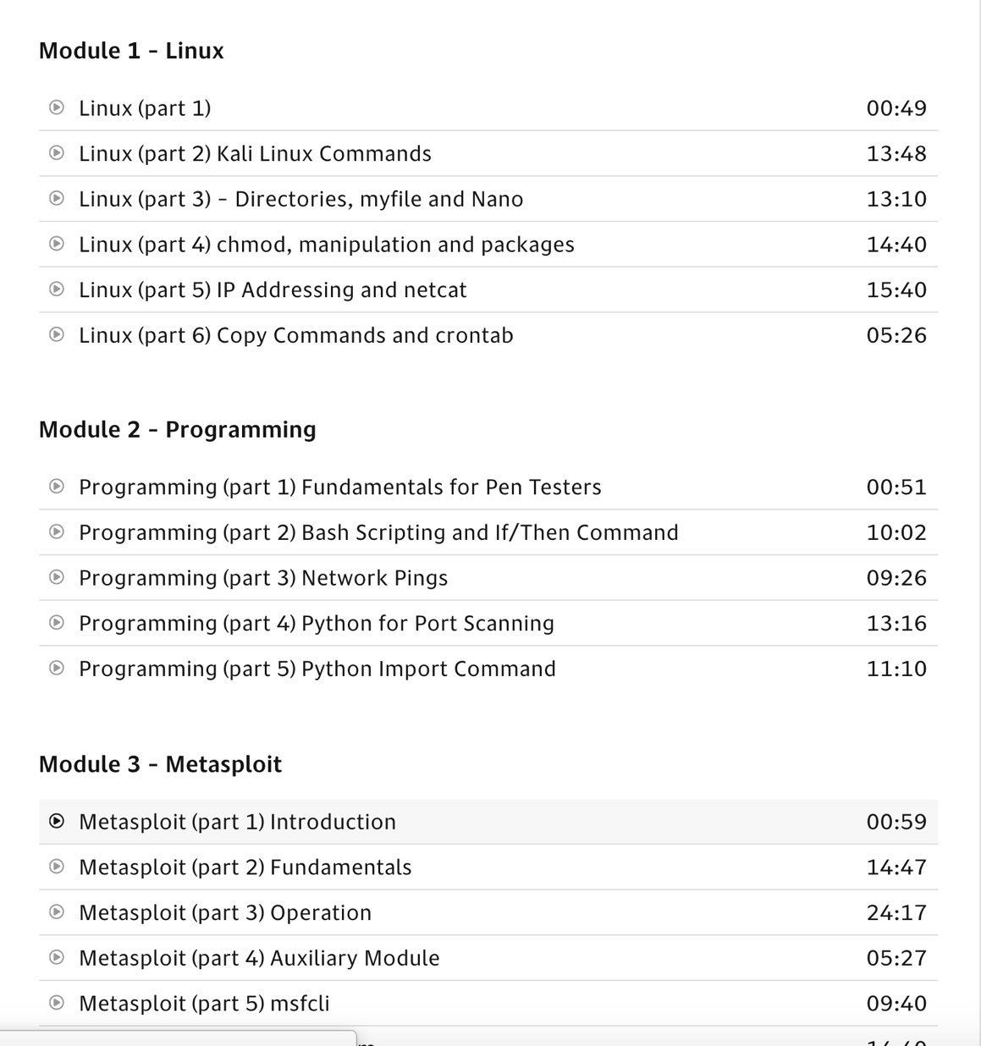
Educational Platform - Cybrary
https://cybrary.it

Slide 16
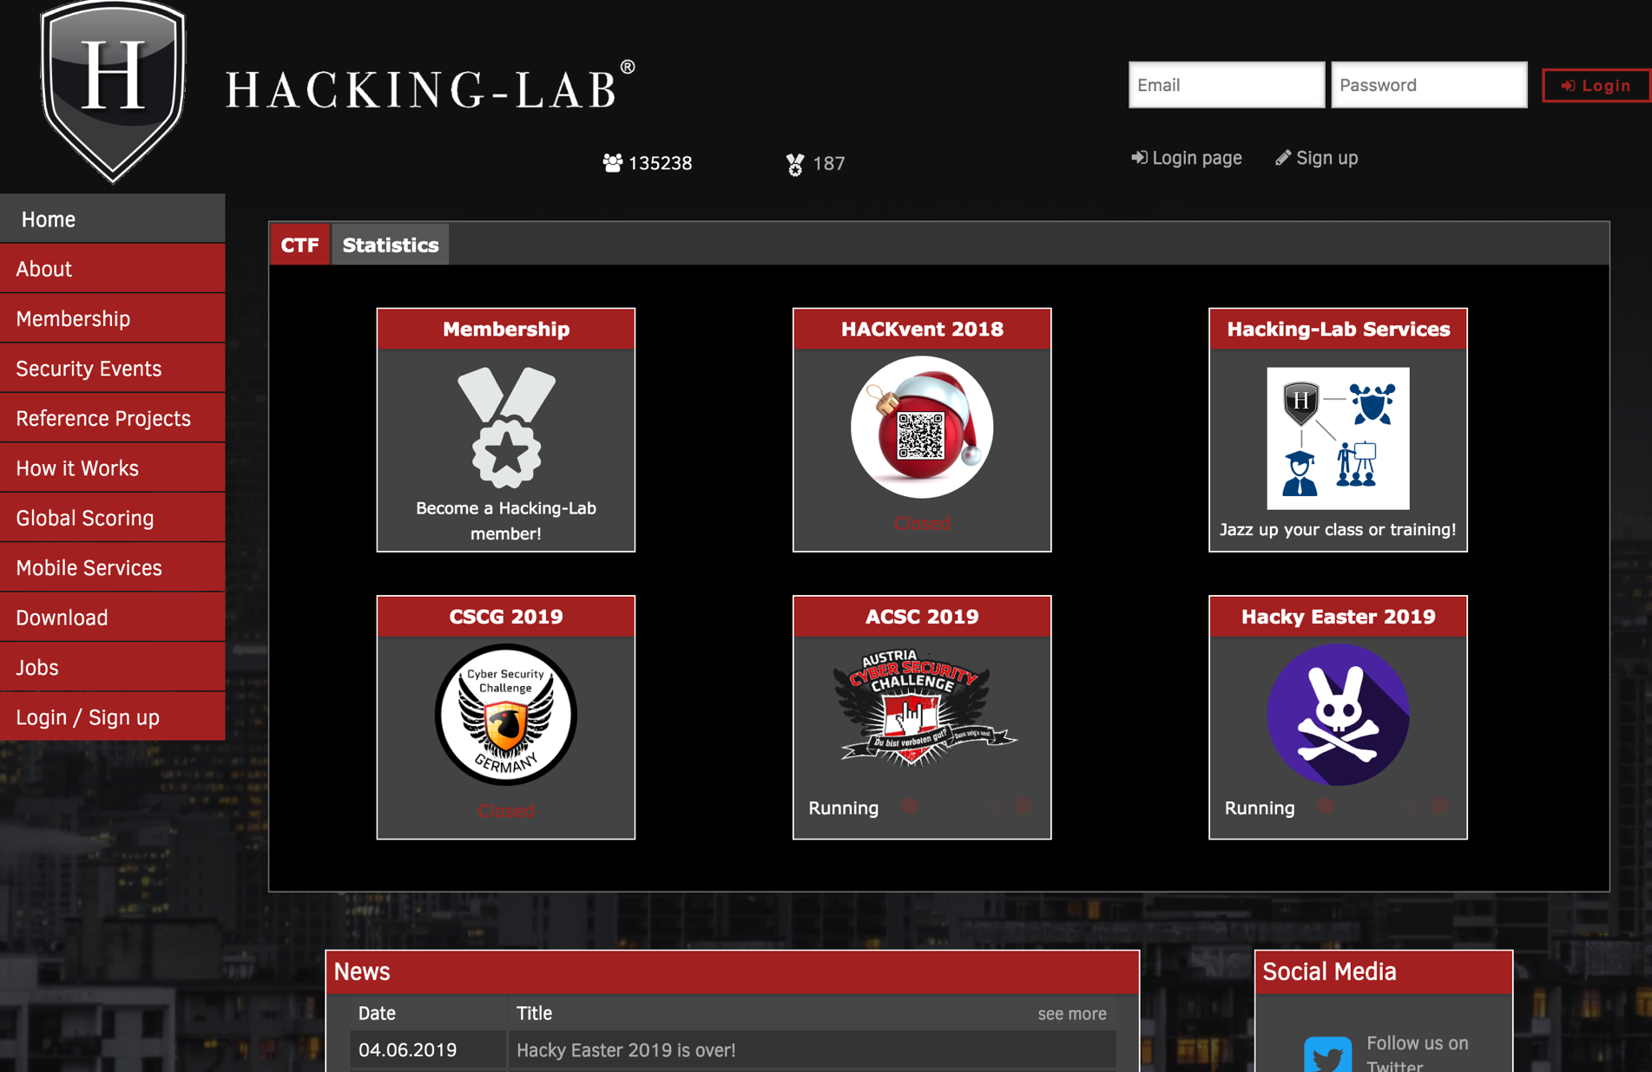
Educational Platform – Hacking-Lab
https://hacking-lab.com

Slide 17

Educational Platform – HackTheBox
https://hackthebox.eu

Slide 18
What do you need?
Motivation and SMALL $
I am afraid I can’t explain myself, sir.
Because I am not myself, you see?
© Lewis Carroll

Slide 19

Vendor - Cisco
Online / Offline
Self passed / Instructor led
University support / Lecturer education / Industry standard
Often locked-in materials (not all) / Often free

Slide 20
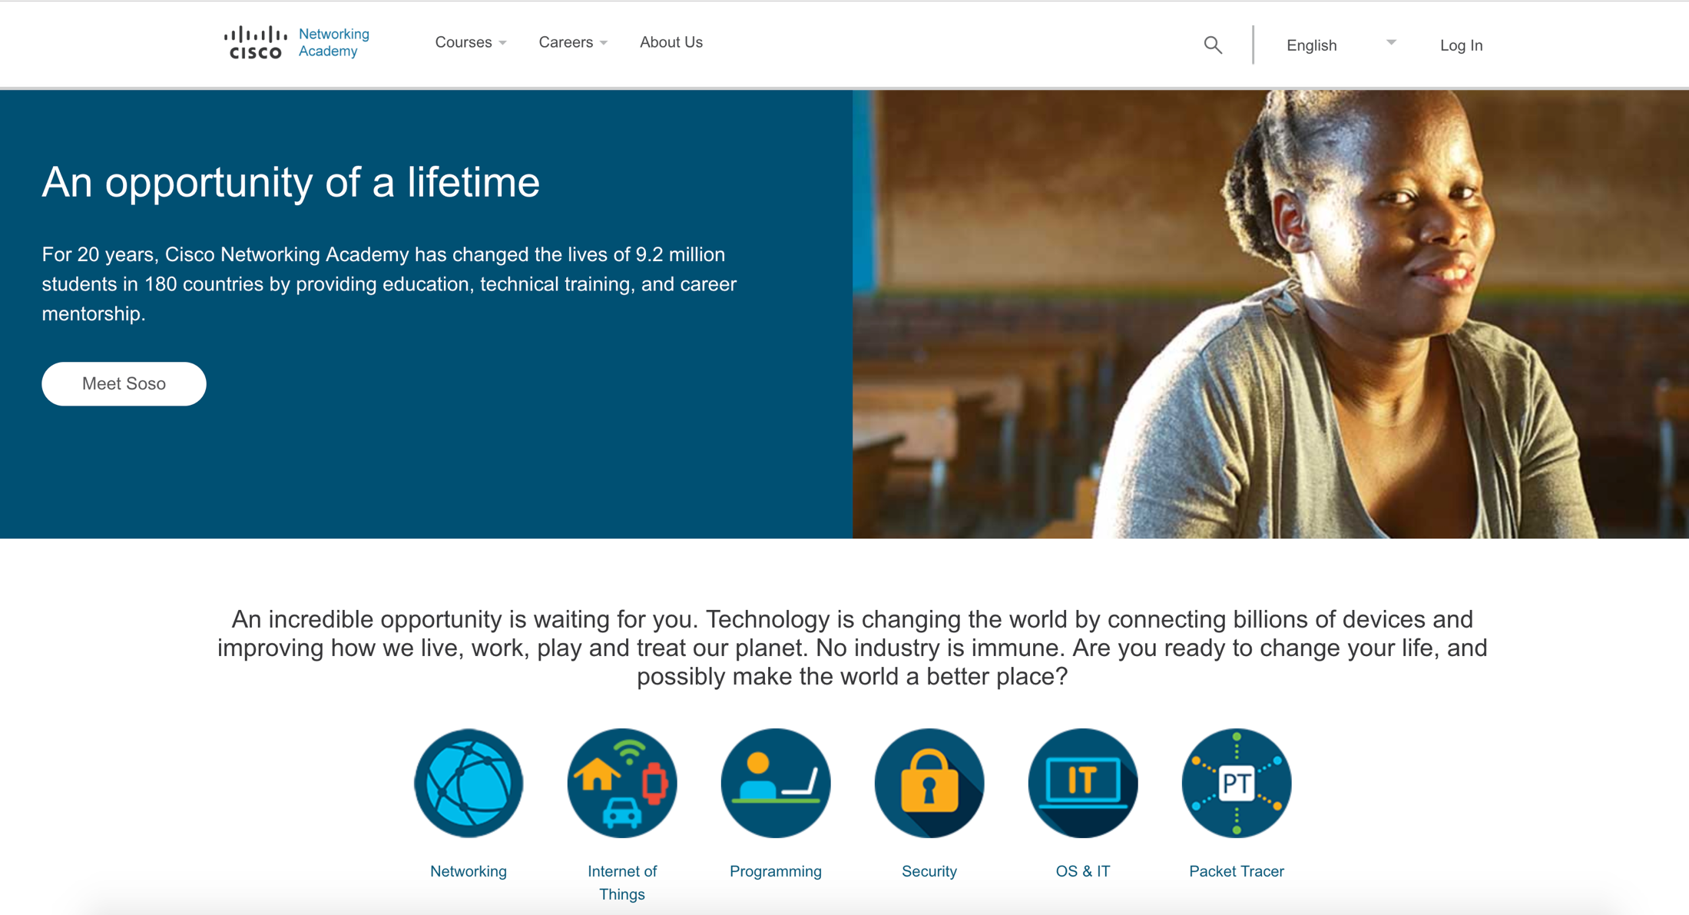
Vendor – Cisco
https://netacad.com

Slide 21
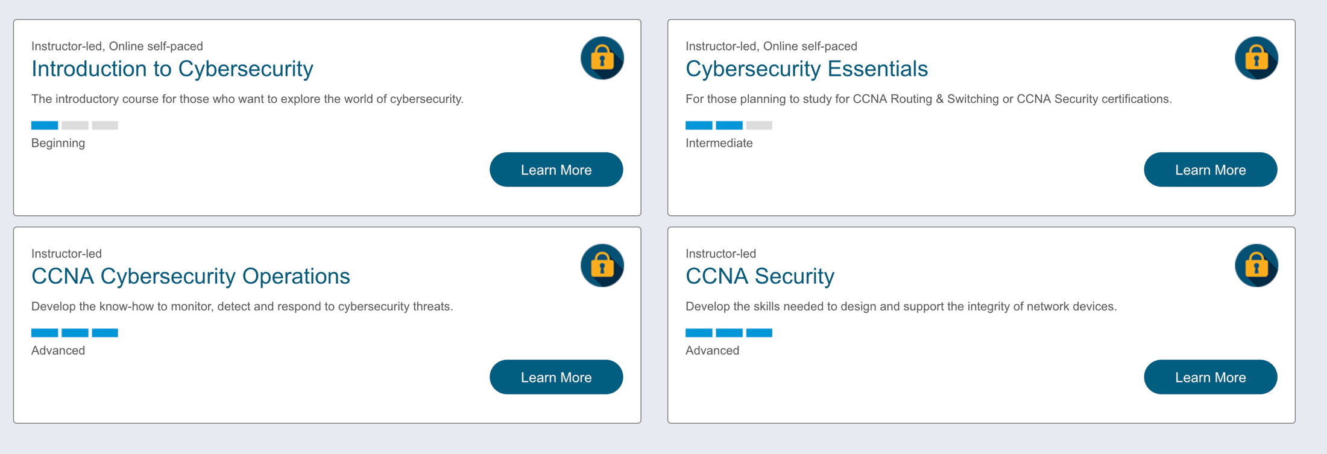
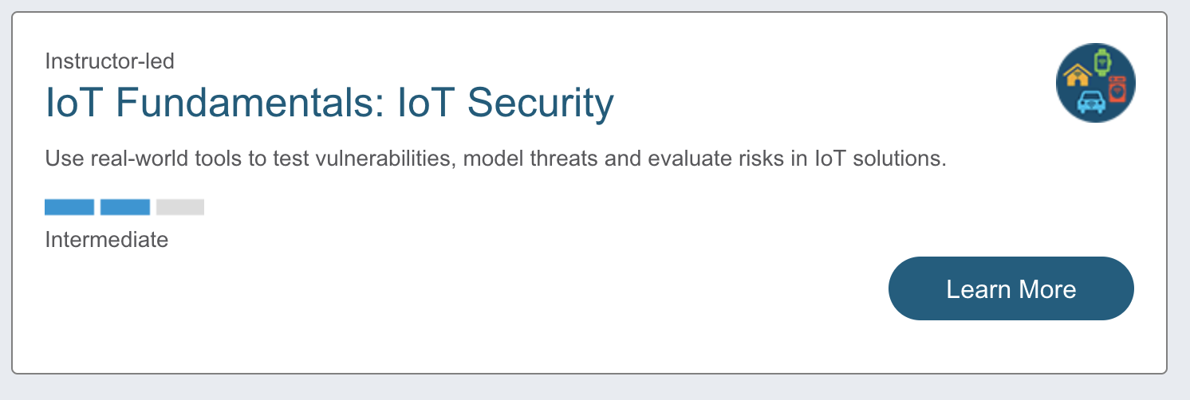
Vendor – Cisco
Curiouser and curiouser © Lewis Carroll

Slide 22

Vendor - IBM
Online / Offline
Academic / Commercial
Self passed / Instructor led
University support / Licensing / Courses
Often locked-in materials

Slide 23

IBM Academic Initiative
https://developer.ibm.com/academic/
First Step

Slide 24
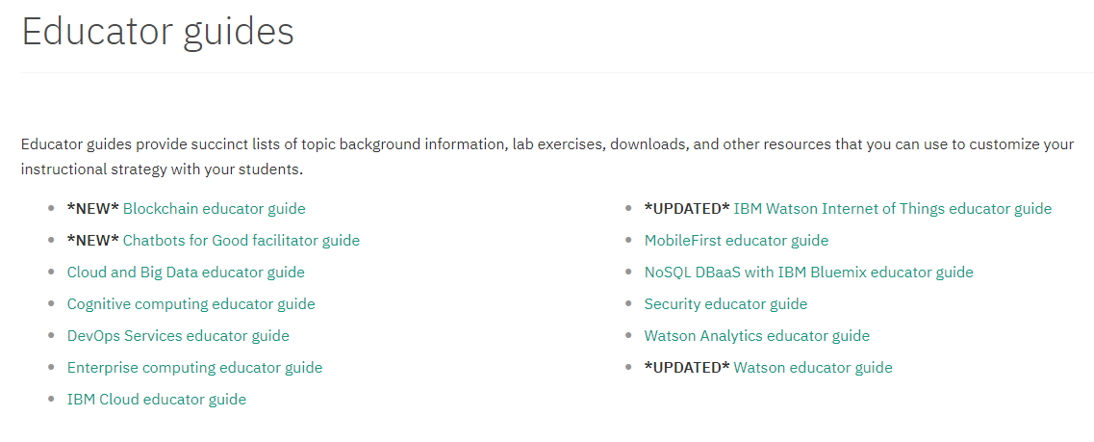
Educator Guides

Slide 25
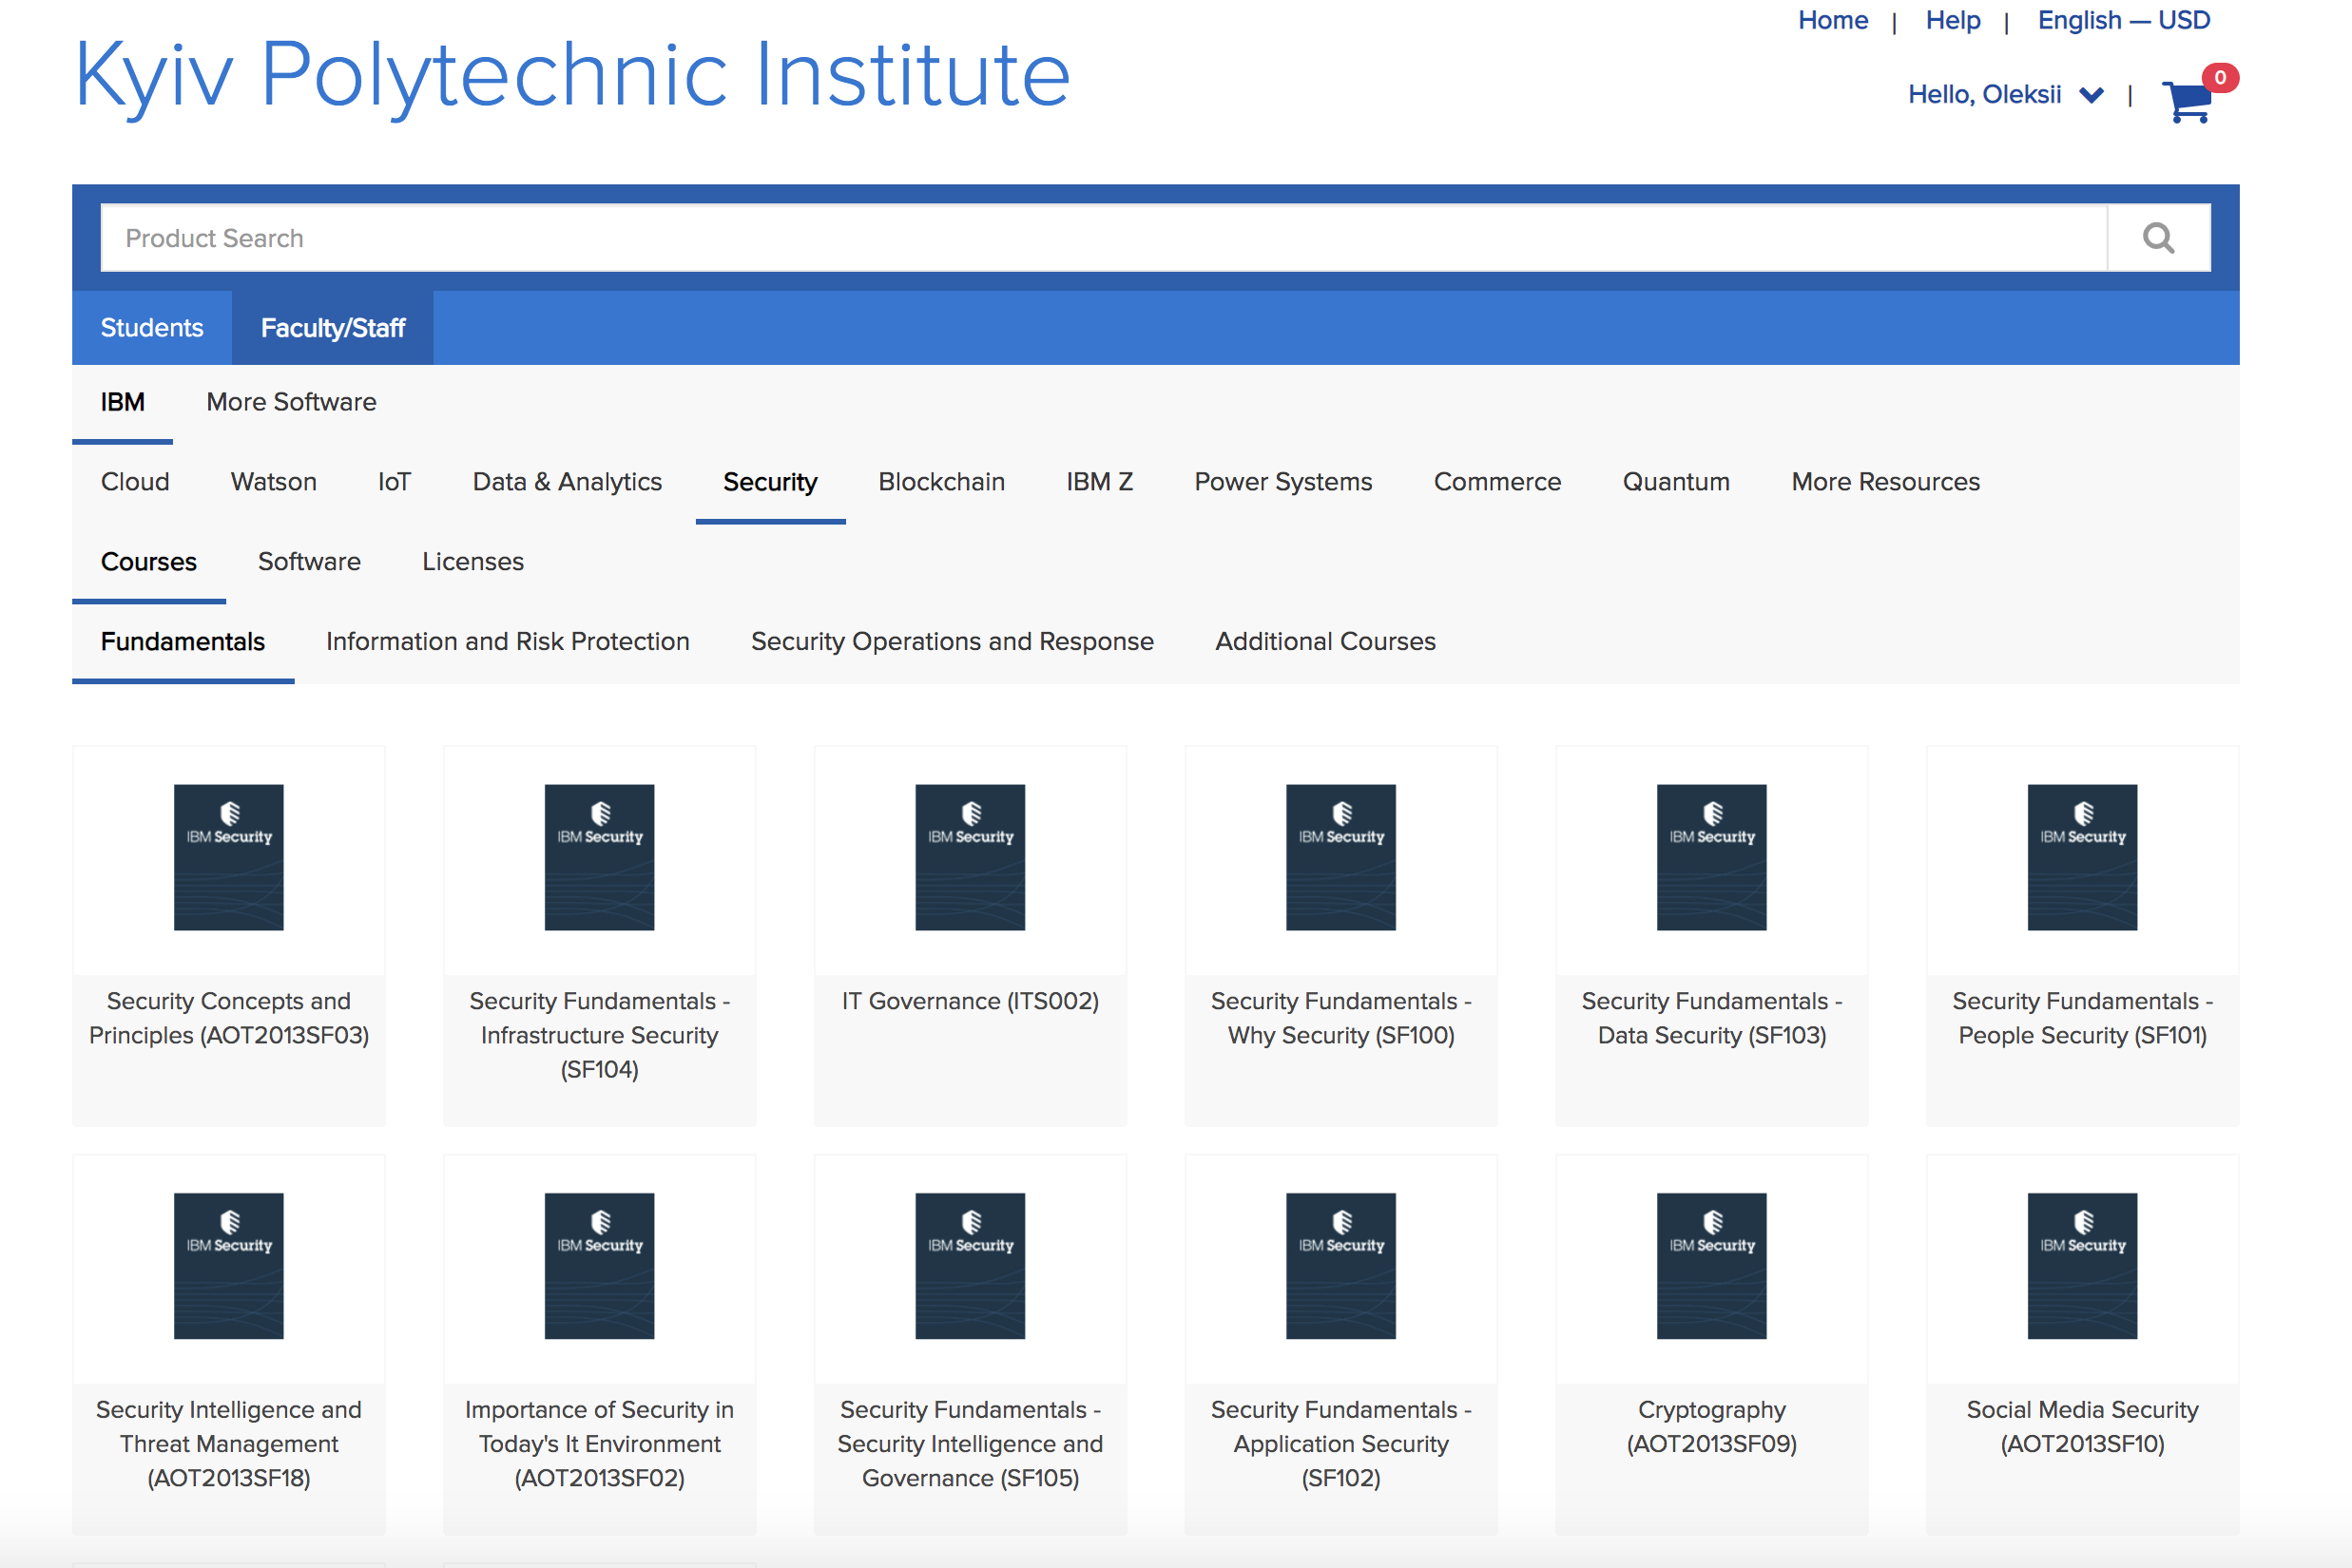
OnTheHub
https://kpi.onthehub.com

Slide 26
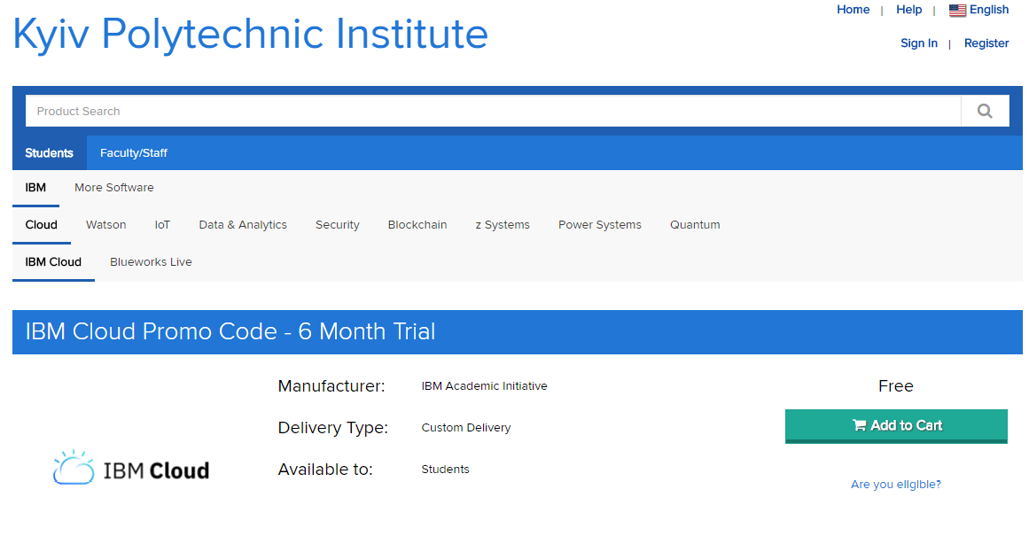
OnTheHub
https://kpi.onthehub.com

Slide 27
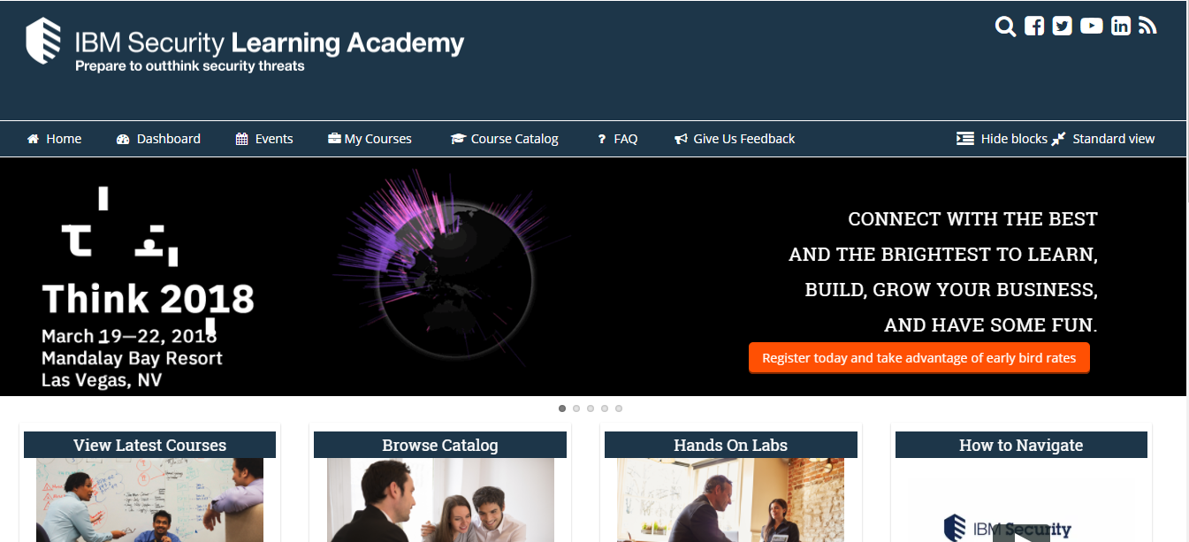
IBM Security Learning Academy
https://www.securitylearningacademy.com/

Slide 28
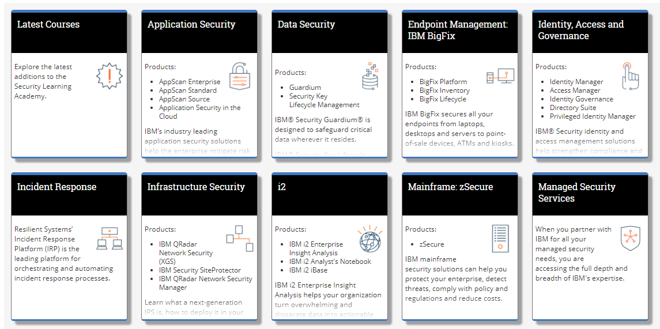
IBM Security Learning Academy
Application Security
Data Security
Endpoint Management
Identity, Access, Governance
Incident Responce
Infrastructure Security
zSecure
Managed Security Services
Mobile Security
Systems Integration
Threat Intelligence
Cyber Security Fundamentals

Slide 29
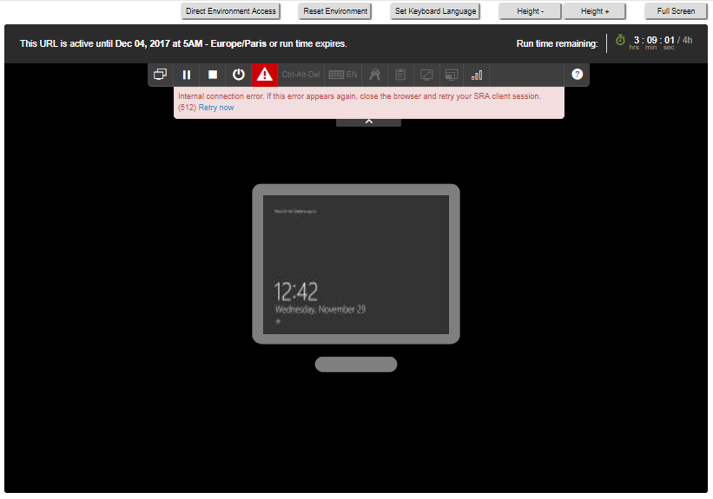
Online Labs

Slide 30
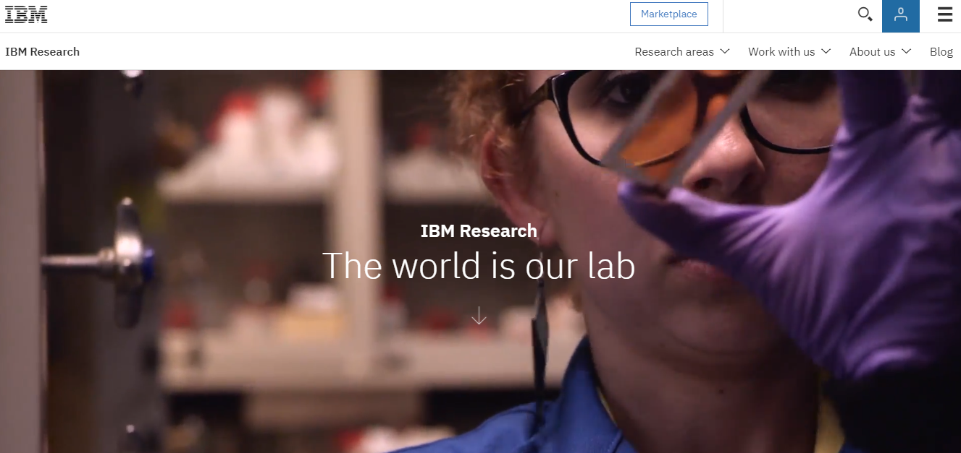
IBM Research
http://www.research.ibm.com/

Slide 31
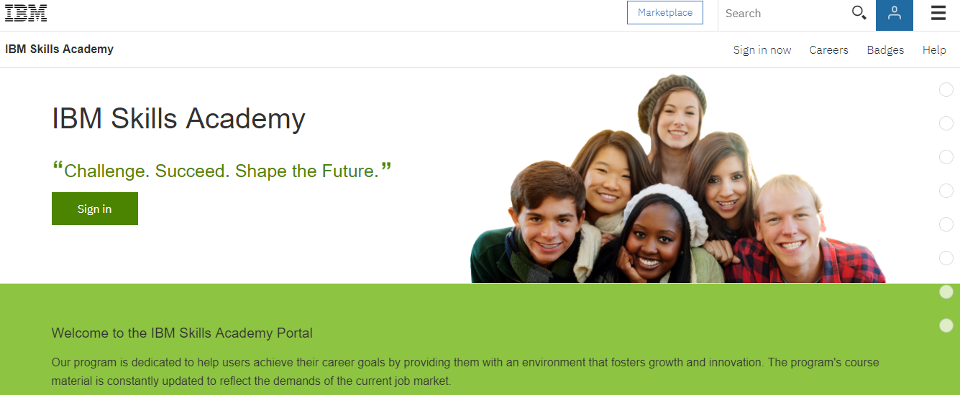
IBM Skills Academy
Search for IBM Skills Academy in Google!

Slide 32






Other Vendors

Slide 33
Are you ready?
Motivation, sometimes $, sometimes mind
If everybody minded their own business, the world go around a great deal faster that it does.
© Lewis Carroll

Slide 34
Cyber Security Certifications
Knowledge based : theory + exam
Action based: practice + result
Experience based: theory + exam + experience
CERTIFICATION
IS
NOT
EDUCATION

Slide 35
Certification organizations
ECCouncil
Mile2
ISACA
eLearnSecurity
Offensive Security
SANS
PECB
CREST
ISTQB

Slide 36

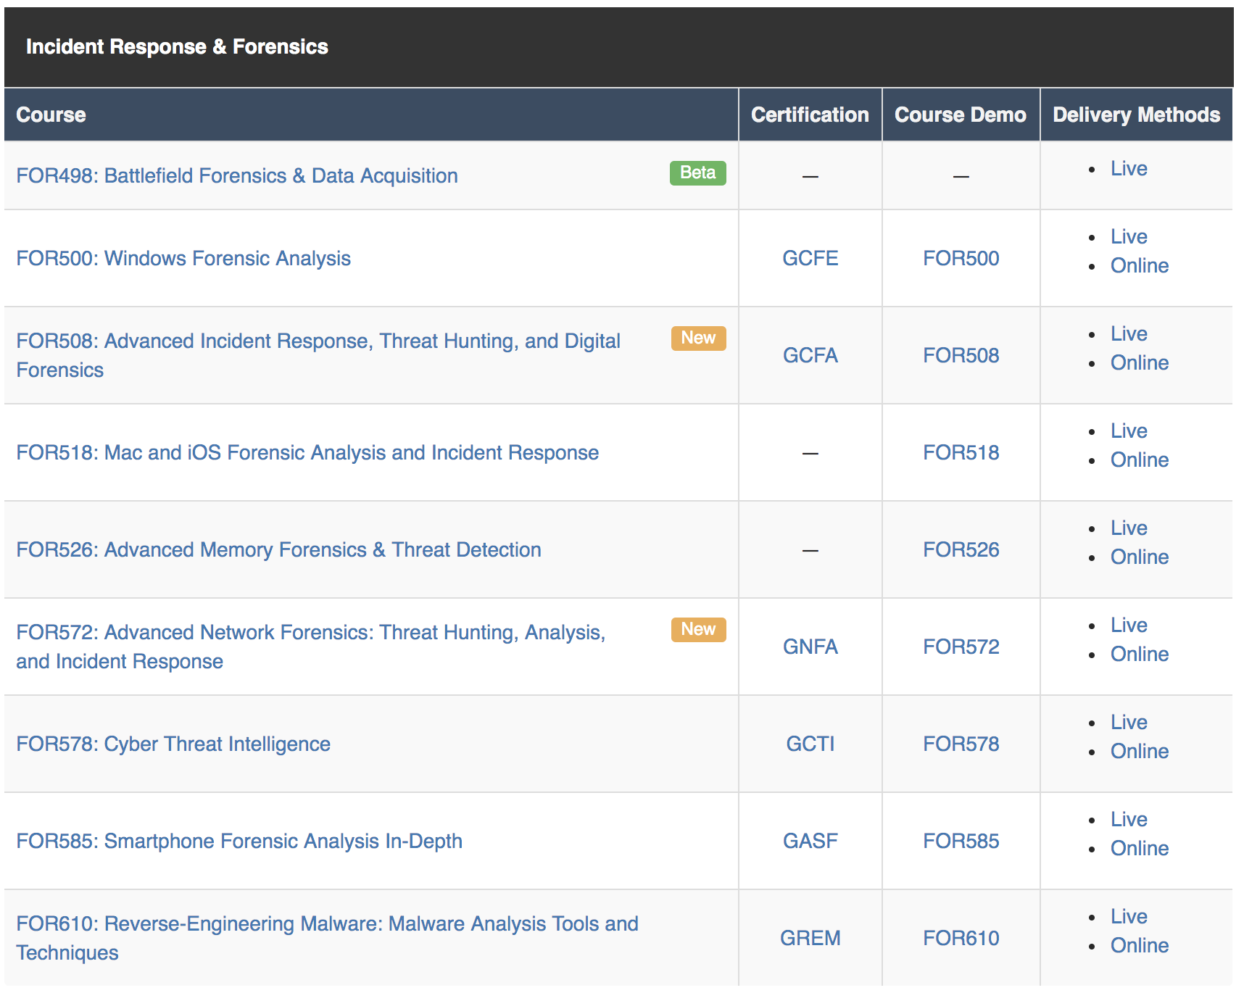
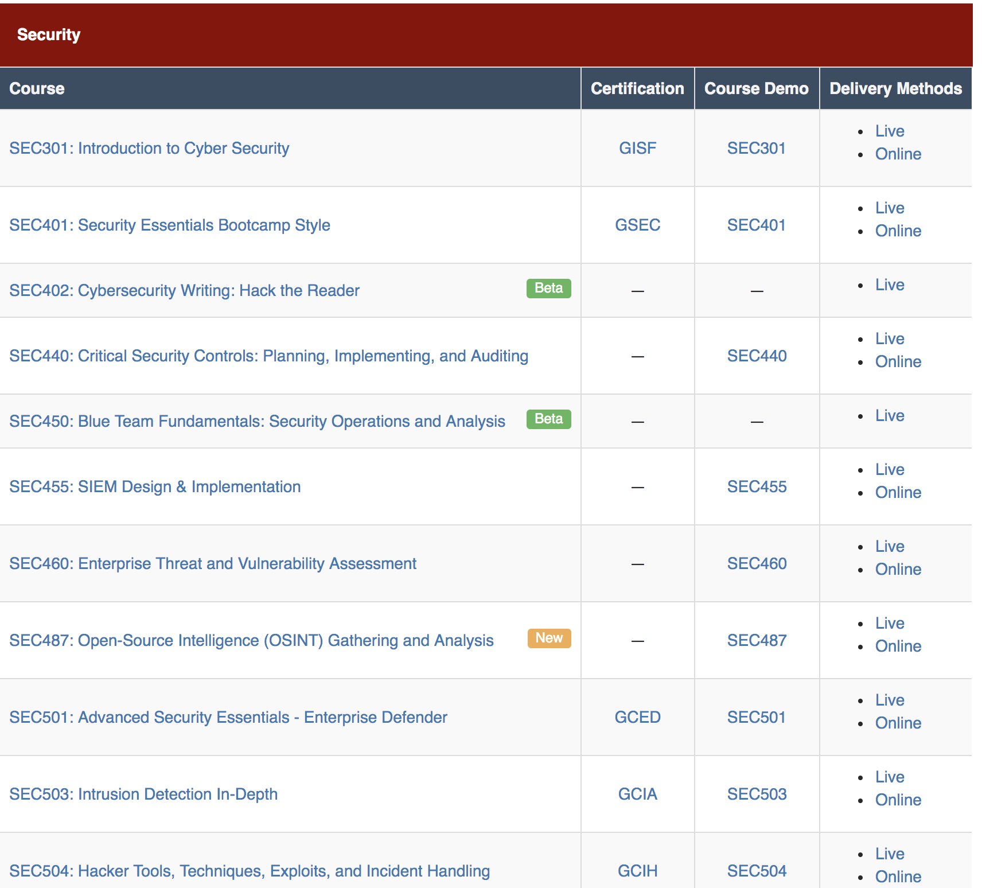
SANS
GCIH, GPT, GCFA etc.
Complex
Full
Online / Offline
Fucking expensive
Theory + Practice
A lot of free materials: cheatsheets, papers, SIFT etc.
Abroad
Bootcamp based
Test

Slide 37
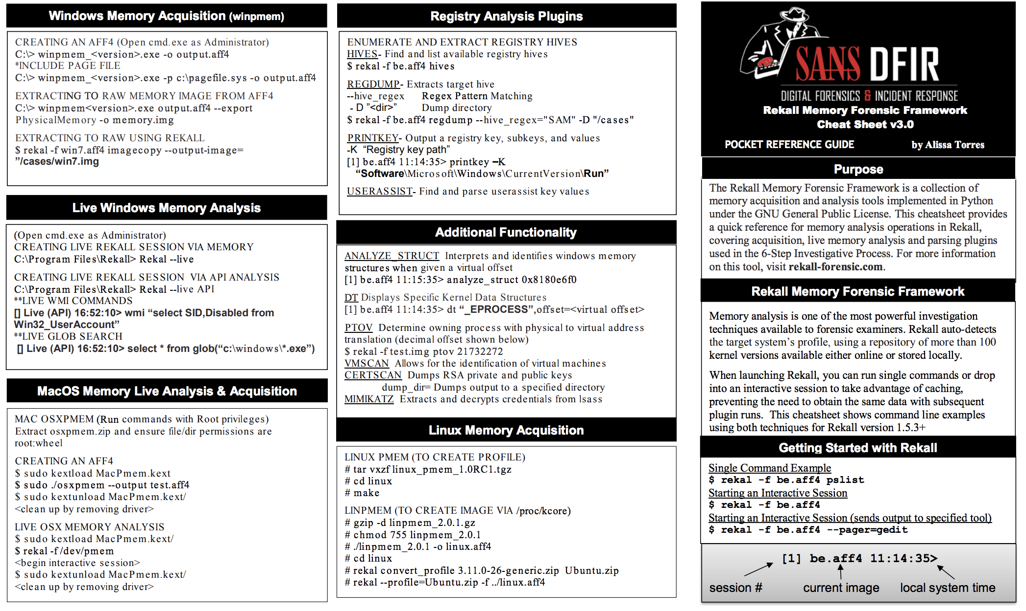
SANS

Slide 38

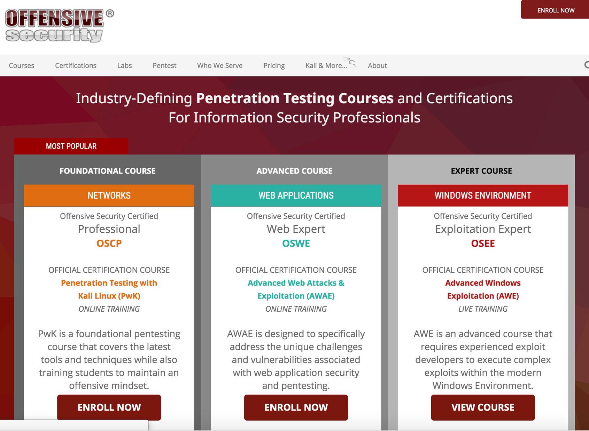
Offensive Security
OSCP, OSCE, OSWP etc.
Complex
Full
Online / Offline
Medium expensive
Almost no theory – PRACTICE!
Try harder
Abroad
Bootcamp based
Result

Slide 39

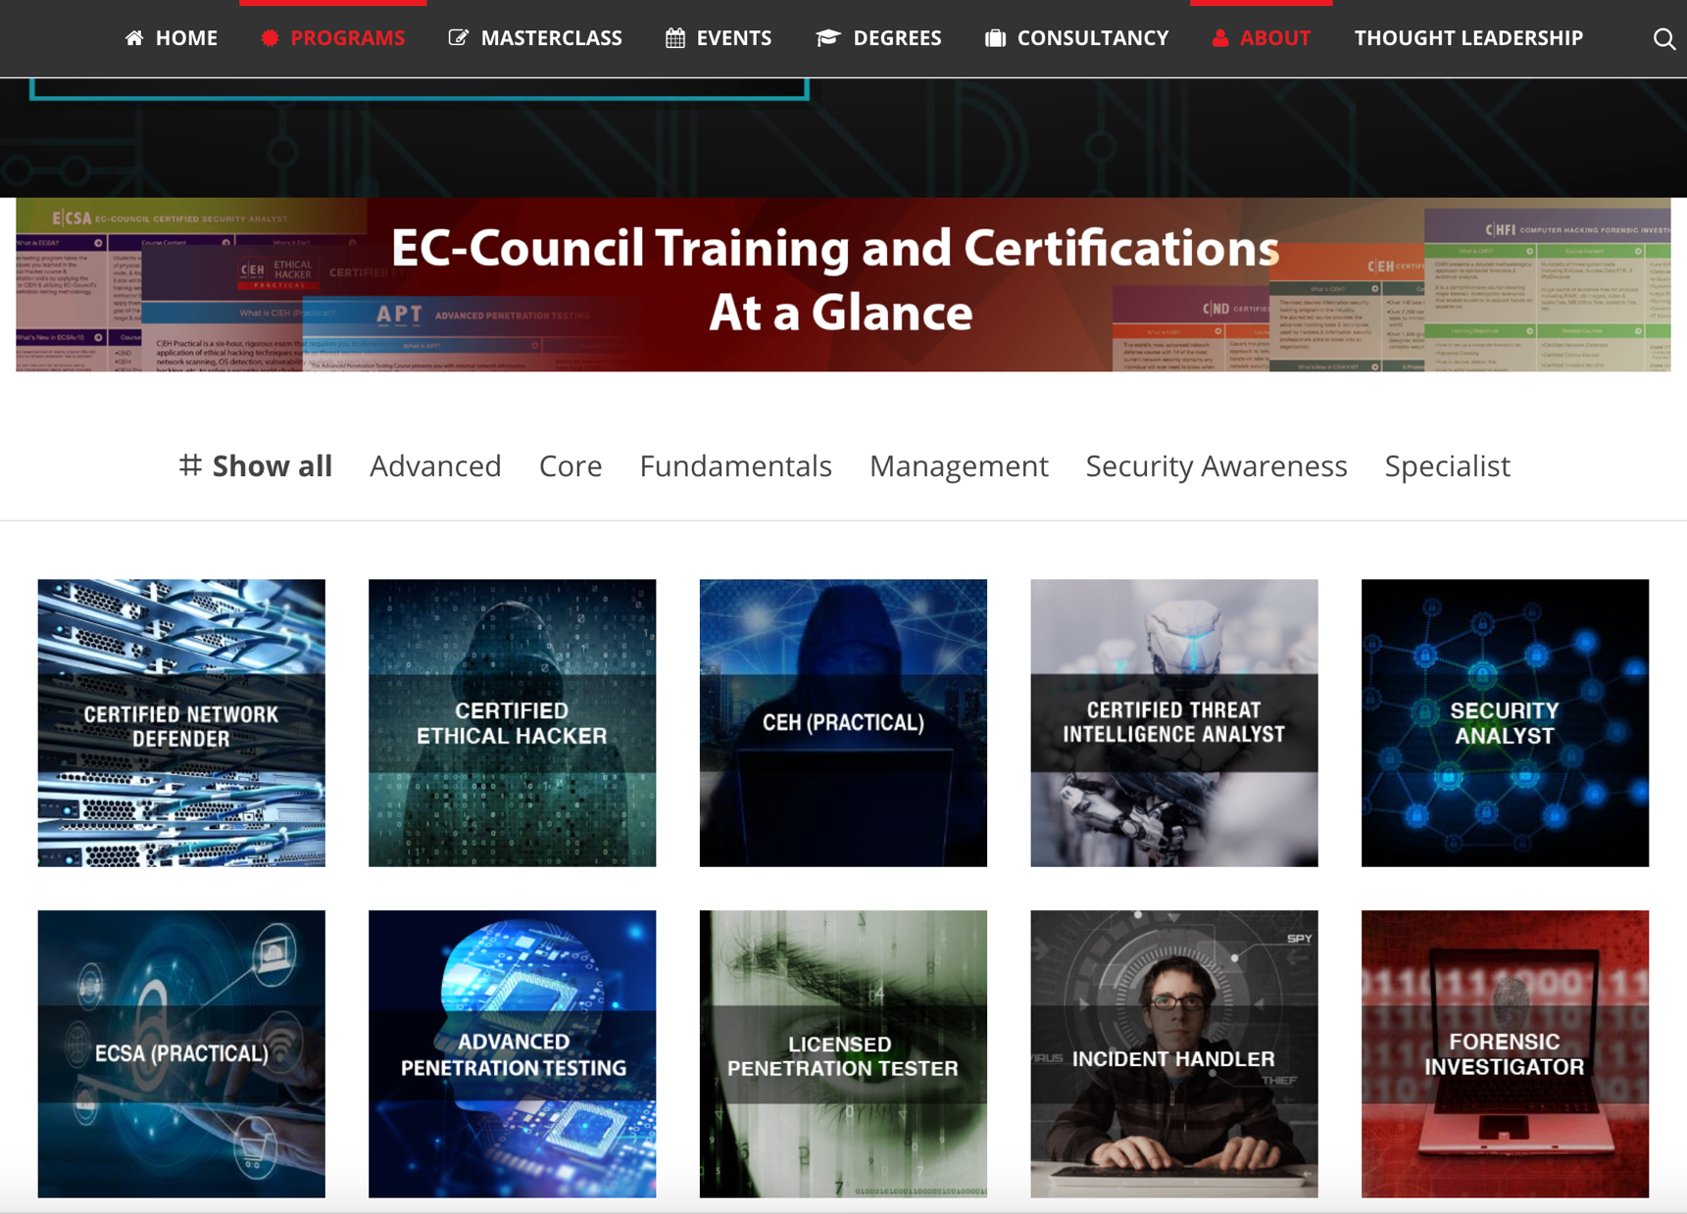
ECCouncil
CEH, CHFI, CND, ECSA, LPT, CCISO etc
Basic / Middle
Offline / Online
Medium expensive
A lot of theory / Small practice
In Ukraine
Bootcamp based
Test / Sometimes result

Slide 40

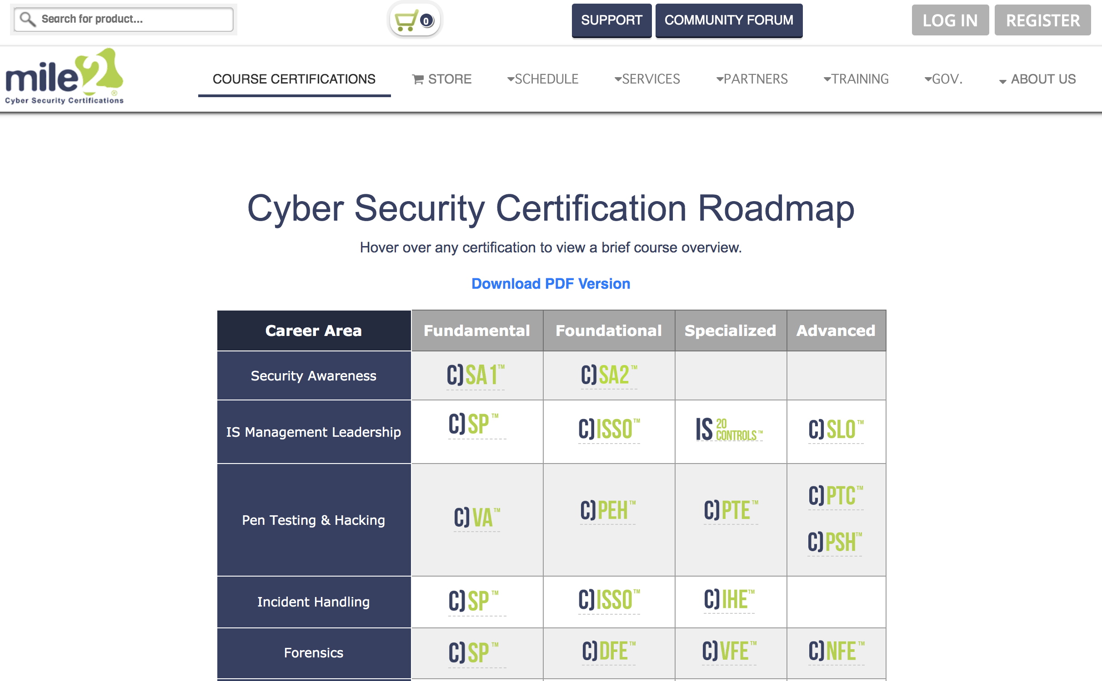
Mile2
CISSO, CPEH, CPTE, CISSM etc.
Basic / Middle
Offline / Online
Medium expensive
A lot of theory / Small practice
In Ukraine
Bootcamp based
Test

Slide 41

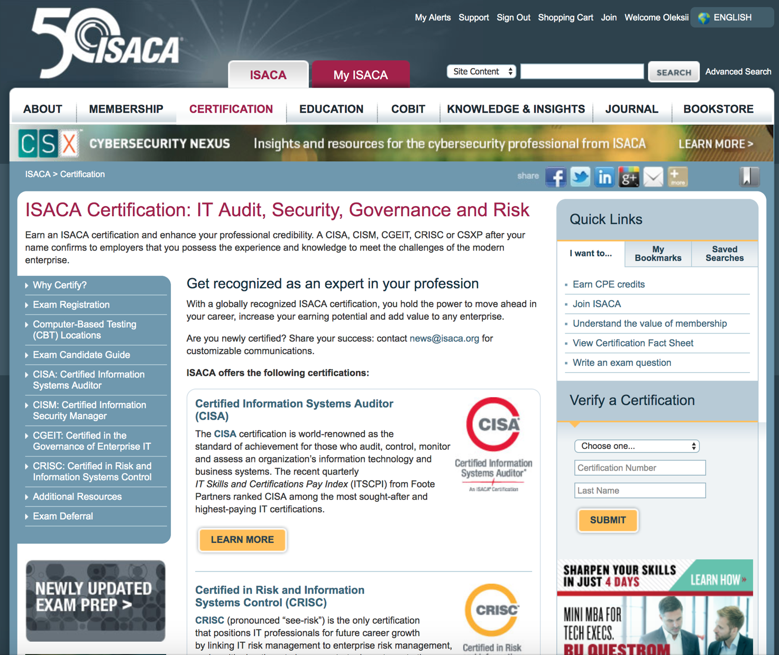
ISACA
CISA, CISM, CRISC, CGEIT, CSX etc.
University support?
Offline
Medium expensive
THEORY!
Specific materials
In Ukraine
Bootcamp based
Test

Slide 42
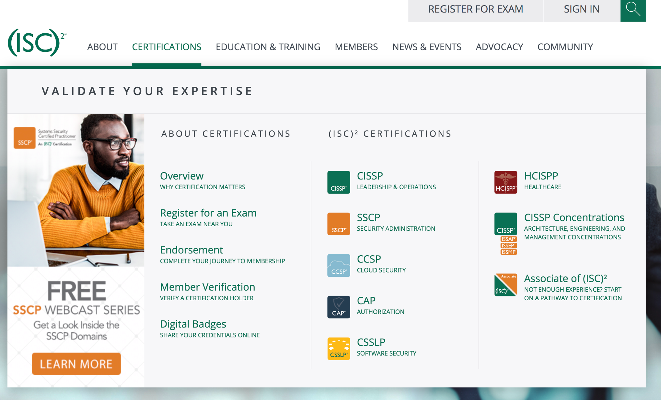
(ISC)2
CISSP, SSCP, CCSP, CCFP etc.
Offline
Medium expensive
THEORY!
Specific materials
In Ukraine
Bootcamp based
FUCKING TEST

Slide 43

eLearnSecurity
eJPT, ePTP, eWAPT, eWPTX, etc.
Online
EDUCATION!
Medium expensive
Theory + Practice
Caendra
Online materials
Abroad
Test + result

Slide 44
Remember
https://learnflakes.com

Slide 45
It’s no use going back to yesterday, because I was a different person then.
© Lewis Carroll

Slide 46
Stay safe!
Any questions?
www.facebook.com/oleksii.baranovskyi
www.linkedin.com/in/oleksiibaranovskyi

